Slide 1
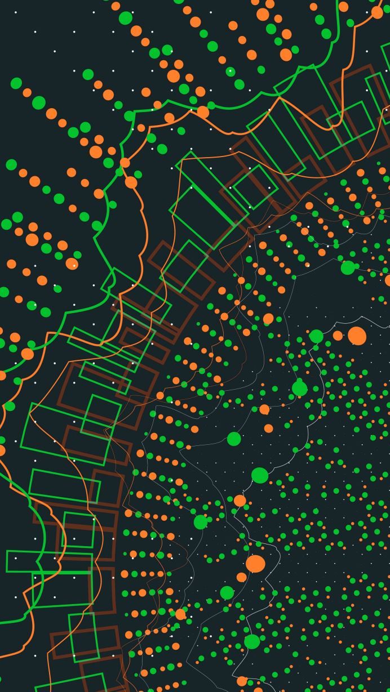
A Comparative Analysis of Credit Rating Model Used In Peer to Peer Lending
By Rik Choudhury
IUBH, Berlin Campus
Advised by Prof. Kunal Saigal

Slide 2
Peer-to-Peer Lending Process
Retail
Institutional
Lenders
Lenders lend money to borrowers for a specified period of time
Borrowerss pay back the principal with interest over the period of the loan.
P2P platform
Borrowers
Consumer
Property
Business

Slide 3
Market view

Slide 4
Research Questions
Which factors are critical to assess the credit risk of the loans?
What properties of borrowers in peer to peer platform are releveant to identifying the nature of the loan and how they are linked to default loans?

Slide 5
Methodology
Data is collected from the loanbooks of the P2P platforms, available publically on their website.
The collected data is processed for identifying key variables. In case of Zopa, the loan observations were divided into 3 categories- Loan Status, Borrower Data and Loan Data.
The focus was on the riskier loans, so default and late categories of loans were looked into. A new category was created to include completed or risky loans and separate form the active loans. Late and default loans were included in High Risk loan category.

Slide 6
Methodology
The lending rates of the loans were identified.
The collected data is processed for identifying key variables. In case of Zopa, the loan observations were divided into 3 categories- Loan Status, Borrower Data and Loan Data.
The focus was on the riskier loans, so default and late categories of loans were looked into. A new category was created to include completed or risky loans and separate form the active loans. Late and default loans were included in High Risk loan category.

Slide 7
Findings
Zopa
ratesetter
9 variables and 734079 observations.
Categories of loan status: Active-35.05%, Completed-56.7%, Default-5.11% and Late-3.05%.
Most of loans were for 12, 24, 36, 48 and 60 months.
Majority of the loans were from Croydon and Greater London area of UK.
Avarage lending rate is 9%. Ranges from 1% to 34%. Maximimun loans carried an lending rate of 2.94%.
In case of sucessful loans had an average rate of 8.73% and the of unsuccessful loans (default or late) is 14.6%
14 variables and 49942 observations.
Categories of loan status: <30 days late-0.98%,>30 days late-0.73%, Hardships-1.47%, In Default-2.83%, On Schedule-46.32% and Repaid-47.57%.
Most loans (30.56%) were of the duration of 60 months.
Majority of the loans were from New South Wales and Greater London region of UK.
Average annual rate of all loans is 6.65% . Ranges from 2.05% to 16.5%. Maximum loans were of 6.92%
In case of successful loans had an average rate of 6% and that of unsuccessful loans(late, hardships and in default) is 7.33%

Slide 8
Findings
Zopa
ratesetter
After the financial crisis of 2008-2009, minimum lending rate decreased to 1%.
The average lending rate has increased gradually from 6% in 2005 to 10% in 2020.
Average amount applied for loan is £ 7183. Many loan were for £ 10000.
Average loan amount for successful loans is £ 6230 where as for unsuccessful loans were £ 7947, relatively higher.
Average no. of payments made towards repayment of the loans in case of successful loans were 21 and in case of unsuccessful loans were 17.6
The average lending rate has decreased over time, from 8.4% to 6.35% for all loans and 8.4% to 5.59% for completed or risky loans.
Durations of loans is between 2014 and 2020.
Average loan amount applied for is £ 13843.
Average loan amount for successful loans is £ 12120 where as for unsuccessful loans were £ 14615, relatively higher.

Slide 9
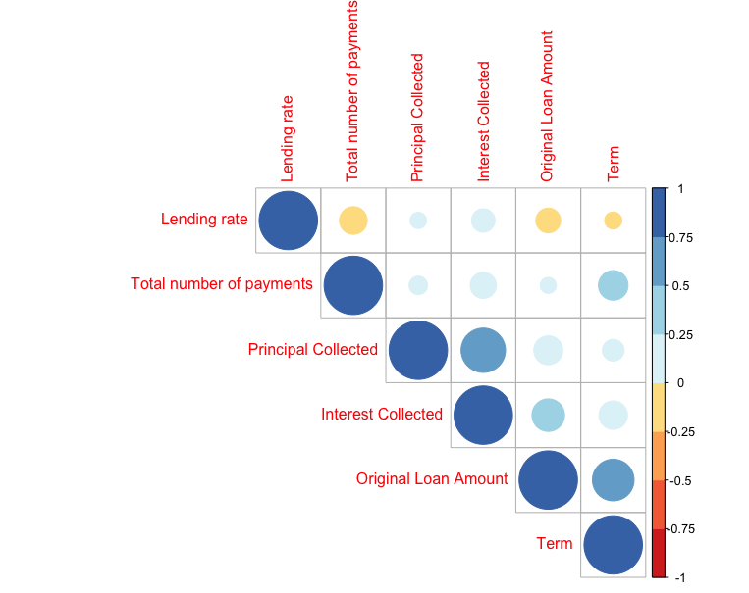
Correlation matrix: Zopa
Borrowers with loans having higher lending rates made less loan repayment.
Loans with higher lending rates tend to repay more interest than the principal of the loan.
Borrowers with loan having bigger amount tend to get cheaper lending rates.

Slide 10
Correlation matrix: zopa(2)
When the term of the loans are longer, the lending rate is lower in comparision to shorter duration of loans.
The higher no. of repayments towards the loan amount shows a higher percentage of principal and interest collected.
Long duration loans have higher no. of repayments made.
When the loan amount is higher, the amount of principal paid as repayment is higher.

Slide 11
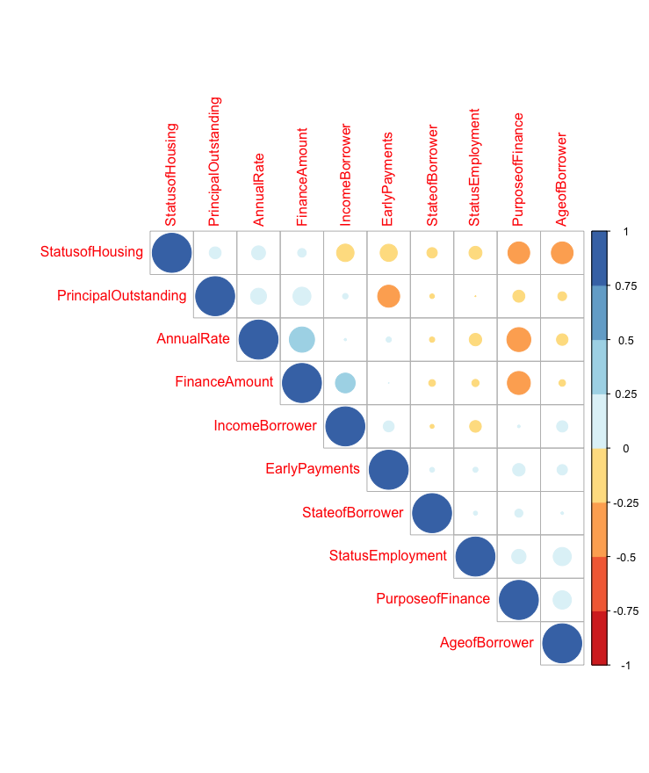
Correlation matrics: ratesetter
Higher loan amount tends to attract lower annual rates.
Borrowers tend to have better housing with age.
Borrowers who take loans for businesses, car or debt consolidation are house owners with or without mortgage.
Borrowers who made early repayments towards their loan have lesser amount of principal outstanding.

Slide 12
Correlation matrix:ratesetter(2)
Loans applied for business, car or debt consolidation have higher annual rates.
Borrowers who had appled for business have higher loan amounts compared to loan taken for solar water heater and energy panels.
Borrowers with higher income tend to borrow more amount.
Borrowers with house with or with mortgage have better income.
Borrowers who are tenants tend to make smaller no. of early payments.
Younger borrowers tend to attract relatively higher annual rates compared to older borrowers.
Borrowers with full time employment tends to own a house.
Self-employed and retired borrowers have lower income compared to full time employees.

Slide 13
Model:zopa
The model is based on logistic regression.
A new variable is created caleed Status with values of either 0 or 1. High risk loans are valued at 1 and completed loans are valued at 0.
4 variables are which can have an impact of the status of the loan is selected- original loan amount, principal collected, lending rate and interest collected.
When the amount of the interest collected is higher, the loan is more promising to be successful by 5.4%.
Loans which have higher lending rates as well as bigger loan amount tends to be more risky with a possibility of default by 1.8% and 5.3% respectively.
When the amount of the principal collected from the loan is higher, the possibility of default is more likely by 5%.

Slide 14
Model:ratesetter
Logistic regression model is created.
NAs in the dataset were replaced by median values to make it continous.
New variable-Status; 1 for high risk and 0 for completed loans.
5 variables which can have impact on the status of the loan is taken for analysis- Annual rate, Principal Outstanding, Borrower Income, Borrower Age and Finance Amount.
Loans which have higher annual rates and bigger principal outstanding are more likely to default by 5.4% and 2.71% respectively.
Younger borrowers are more likely to repay loans. Older borrowers tends to have risky loans by 2.3 to 2.6%.
Borrowers with bigger loan amount have less risky loans by 1.7%
High income borrowers have less likely risky loans. If income is higher than 150K, the risk of loan being default reduces by 5.7%.

Slide 15
comparision
Zopa
ratesetter
Rate of default is 5.11% for the duration of 2005-2020.
Out of all loans, the percent of high risk loans is 12.59%
More locations of borrowers.
Loan amounts are more spread around and uniform.
Higher mean disbursal value per month.
Rate of default is 2.83% for the duration of 2014-2020.
High risk loans were 11.19% out of all the loans.
Lesser locations.
Loan amounts are concentrated over period of time.
Lower mean disbursal value per month.

Slide 16
Conclusion
Peer-to-peer lending marketplace will revolutionise the relationship between lenders and borrowers.
Third party companies like payments, data gathering and cleaning and research analysis are joining in this marketplace.
In both platforms, loans with higher interest rates tend to be more risky in nature.
An unsual pattern is observed in Zopa, when the principal collected is higher, the loan tends to be risky and in Ratecutter, when principal outstanding is higher, the loan tends to be risky.
In RateSetter, higher loan amount tends to reduces the risk of the loan.
Some benefits of P2P platform is risk adjusted return, diversification; risks include performance risk, platform risk, market and liquidity risk.

Slide 17
Thank you

